Slide 1

Movie Booking Mobile Application
Mobile Computing Project-Phase 2

Slide 2

Project Members
Santhosh Reddy Velpula(S02015486)-Team Leader
Satish Reddy Velpula(S02008578)
Venkata Naga Bhaskar Chennupati(S02012416)
Venkata Avinash Gupta(S02012660)
Baby Laxmi Sindhu Yanala(S02009823)

Slide 3

Abstract:
Movie Booking app is a ticket Booking application use to provide easy service of tickets to the customers and improve the sales by being available to the users all the time. The service that is provided through this application is ticket ordering by customer through mobile app using internet. Application helps user to reduce work and time in day-to-day life.

Slide 4
Agenda
1 Development
2 Integration and testing
3 Implementation
4 Evaluation and future work.

Slide 5
Development
In this second phase of project we have developed the online ticket booking application in html, css, JavaScript, Java and Docker .
Technologies used :
XML
Java
HTML
CSS
Docker
SQL

Slide 6
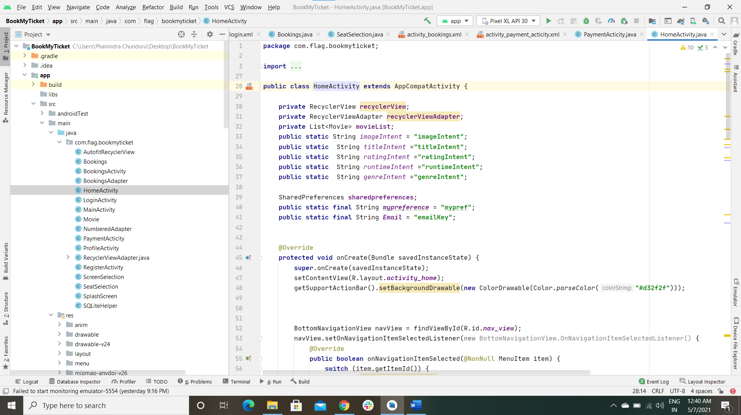
Development-Home Page
The snippet shows development code of the Home Page of the application.

Slide 7
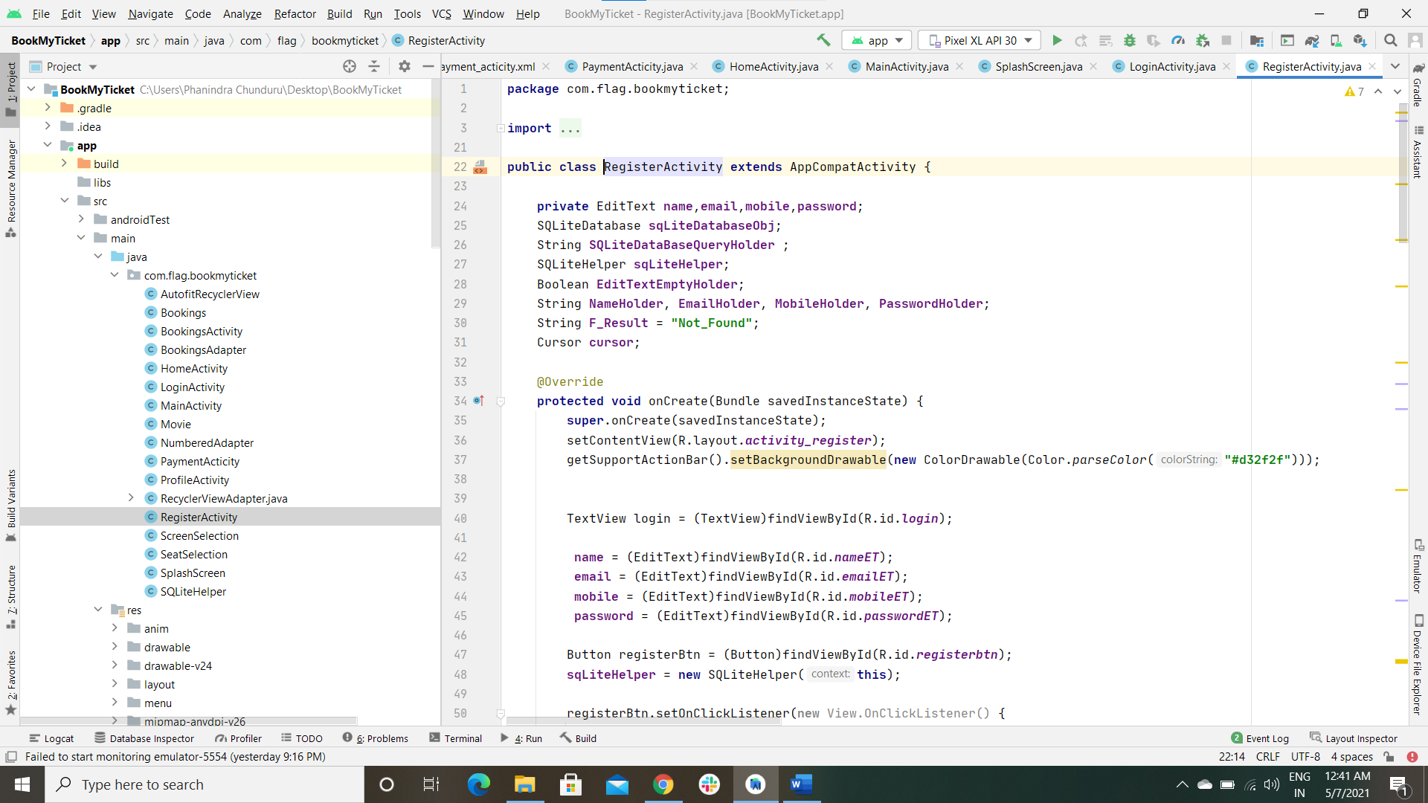
Development-Register Page
The snippet shows development code of the Register Page of the application.

Slide 8
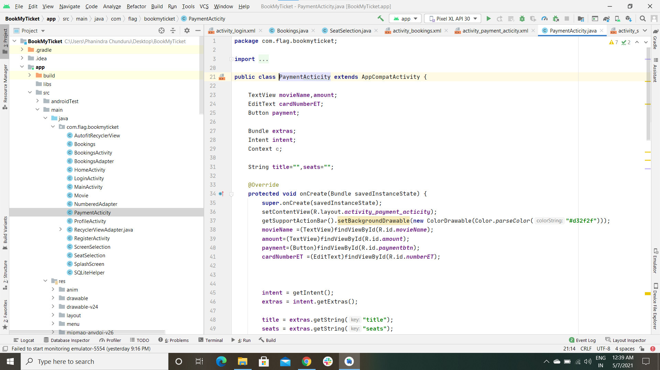
Development-PAYMENT Page
The snippet shows development code of the Payment Page of the application.

Slide 9
Integration
Software integration is the process of bringing together various types of software sub-systems so that they create a unified single system. Software integration can be required for a number of reasons, such as: Migrating from a legacy system to a new cloud system, including cloud-based data storage.
I have used GIT as version controlling system to integrate all the components that each member developed.
Junit and Appium is used for unit and integration testing.
localhost server to run the application on local host ser

Slide 10
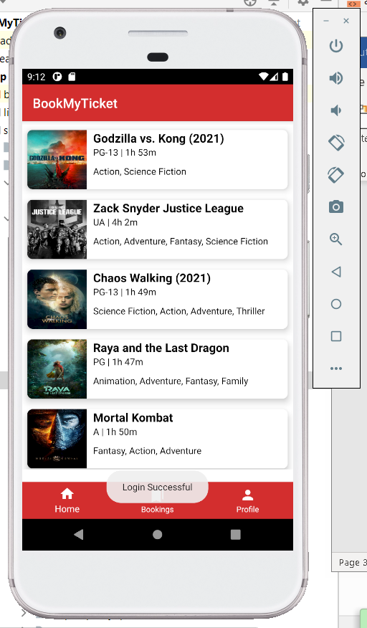

Integration

Slide 11
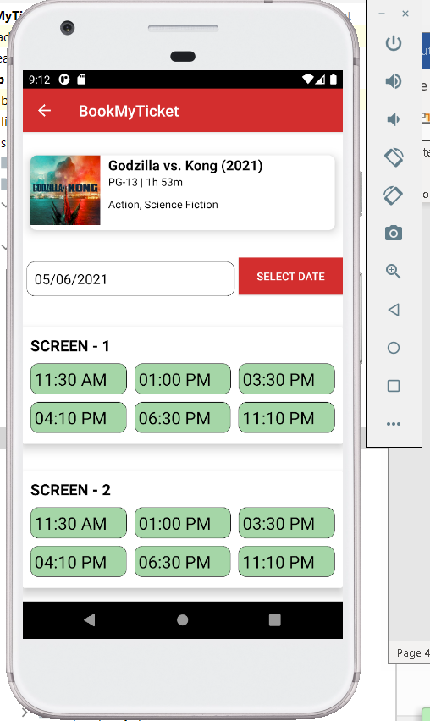
Integration(contd.,)

Slide 12
Test-Cases
HOME-PAGE:
Click on any button in the home page like Home, Bookings, Profile page should get navigated to particular page.
MENU PAGE:
Click on corresponding movie page and the page should redirect to the particular page.
Check whether user can see available screens under the movie that has selected.

Slide 13
Test-Cases
Seat Selection Page:
When We click on particular seat, check whether it is adding to cart or not.
Check whether the second seat is adding to list or not.
Verify whether the total price is calculating correct.
Check by clicking the seat button on one of the seat selected and verify the item is removed from list or not.
Check whether the total price is changed for the number of quantity added.
Click action on Book seats is redirecting to payment page or not.
Payment Page:
Validate whether user is able to pay through card.
Check whether the Radio buttons are getting selected or Not.
Verify whether the payment is done once all the fields are filled.
Check whether the Popup Message is displaying after Confirm Payment or not Like “Thank for your Purchase”.
When we click on Menu Button check whether it is redirecting to the menu page or not.

Slide 14
Implementation – HOME PAGE OF THE APPLICATION
A mobile app for Movie bookings is our team plan to develop and design based on the developing technology with internet where users spend more time to purchase and book in online rather than going to theatre and book tickets. Developing this application helps to develop the business sales and services in the real world.
A user friendly application is designed taking-in view of the user’s perspective. To make application work more efficiently and satisfy user convenience page navigation and instructions are more accurate and clearly to be designed
Application includes the title, Home, Menu, Payment page, Seat selection page.

Slide 15
IMPLEMENTATION –Screen selection page
Click on the particular movie page the that is displayed in the home page.
Select the date in which user wants to go to movie.
User has option to select the different screens provided for that movie .
If user selects any of the screens the show timings the available seats of the screen page will be displayed.

Slide 16
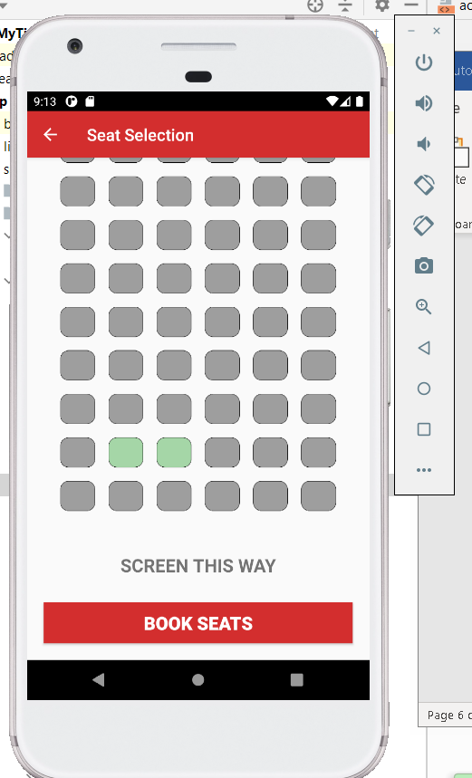
Implementation – SEAT SELECTION PAGE
The list of seats that are used to book by the user are displayed under the Seat selection page.
If user wants to remove the seat from the list , simply click on seat Button to delete the seat from page.
After user selects the seats and the proceed to book tickets, the page will redirect to the payment page.

Slide 17
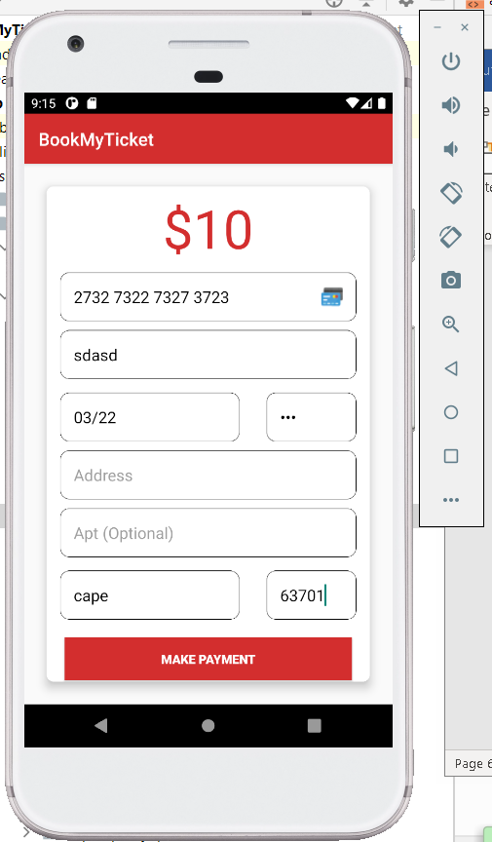
IMPLEMENTATION –PAYMENT Page
Here is the user payment Page after the seat selection Page.
User enters the card details with name , card number, Address etc and click on proceed to make the Payment.

Slide 18
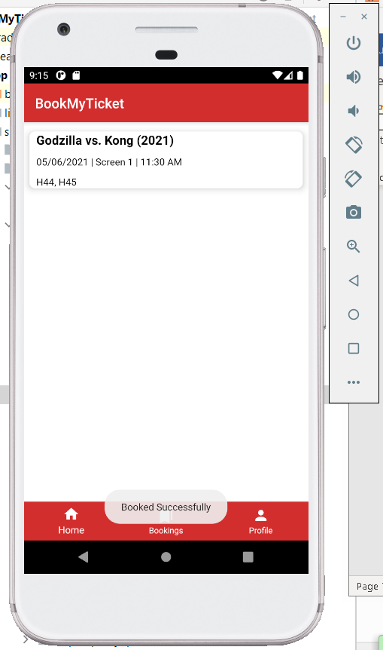
Implementation – ConFIRMATION page
The confirmation details of the tickets booked page is displayed in this page for user to use it as a reference.
Seat numbers,Timings and screen of the theatre will be displayed in this page.

Slide 19
Future Work
Analysing the user data by saving user data and store the details of user into the database and giving suggestions for the future bookings.
Using the recent booking details of user and auto populate those details into current bookings.
Giving deals for the regular customers.
Blog for future events can be designed in the existing pages.
Improvement in page response time.

Slide 20
Individual Contribution
Task/Team Member Contribution | Santosh Reddy V | Venkata Naga Bhaskar Chennupati | Satish Reddy V | Sindhu Yanala | Venkata Avinash Gupta C R
Development | 30% | 15% | 15% | 15% | 25%
Integration | 15% | 30% | 10% | 10% | 20%
Testing | 25% | 25% | 25% | 15% | 10%
Implementation | 20% | 20% | 20% | 20% | 20%
Evaluation | 15% | 15% | 25% | 25% | 15%
Future Works | 15% | 15% | 20% | 25% | 25%

Slide 21

Any queries?
Please ask in the discussion forum

Slide 22

Thank you

